Slide 1
Data Mining (CS 451)
JAN-MAY’ 18
PRAGYA VERMA

Slide 2
RECAP
Frequent Itemset Mining Methods
Apriori Algorithm: Finding Frequent Itemsets by Confined Candidate Generation
Generating Association Rules from Frequent Itemsets
Improving the Efficiency of Apriori

Slide 3
CONTENT
A Pattern-Growth Approach for Mining Frequent Itemsets
Mining Frequent Itemsets Using the Vertical Data Format
Pattern Evaluation Methods

Slide 4
A Pattern-Growth Approach for Mining Frequent Itemsets
The keys drawbacks associated with Apriori algorithm are:
It needs to generate a huge number of candidate sets
It may need to repeatedly scan the whole database and check a large set of candidates by pattern matching.
Can we design a method that mines the complete set of frequent itemsets without such a costly candidate generation process?
An interesting method in this attempt is called frequent pattern growth, or simply FP-growth.

Slide 5
Pattern-Growth Approach (Contd.)
Frequent pattern growth, or simply FP-growth, adopts a divide-and-conquer strategy.
First, it compresses the database representing frequent items into a frequent pattern tree, or FP-tree, which retains the itemset association information.
It then divides the compressed database into a set of conditional databases, each associated with one frequent item or “pattern fragment” and mines each database separately.
For each “pattern fragment”, only its associated datasets need to be examined.

Slide 6
Mining Frequent Itemsets Using the Vertical Data Format
Both the Apriori and FP-growth methods mine frequent patterns from a set of transactions in TID-itemset format (i.e., {TID: itemset}), where TID is a transaction ID and itemset is the set of items bought in transaction TID.
This is known as the horizontal data format.
Alternatively, data can be presented in item-TID_set format (i.e., {item: TID_set}), where item is an item name, and TID_set is the set of transaction identifiers containing the item.
This is known as the vertical data format.

Slide 7
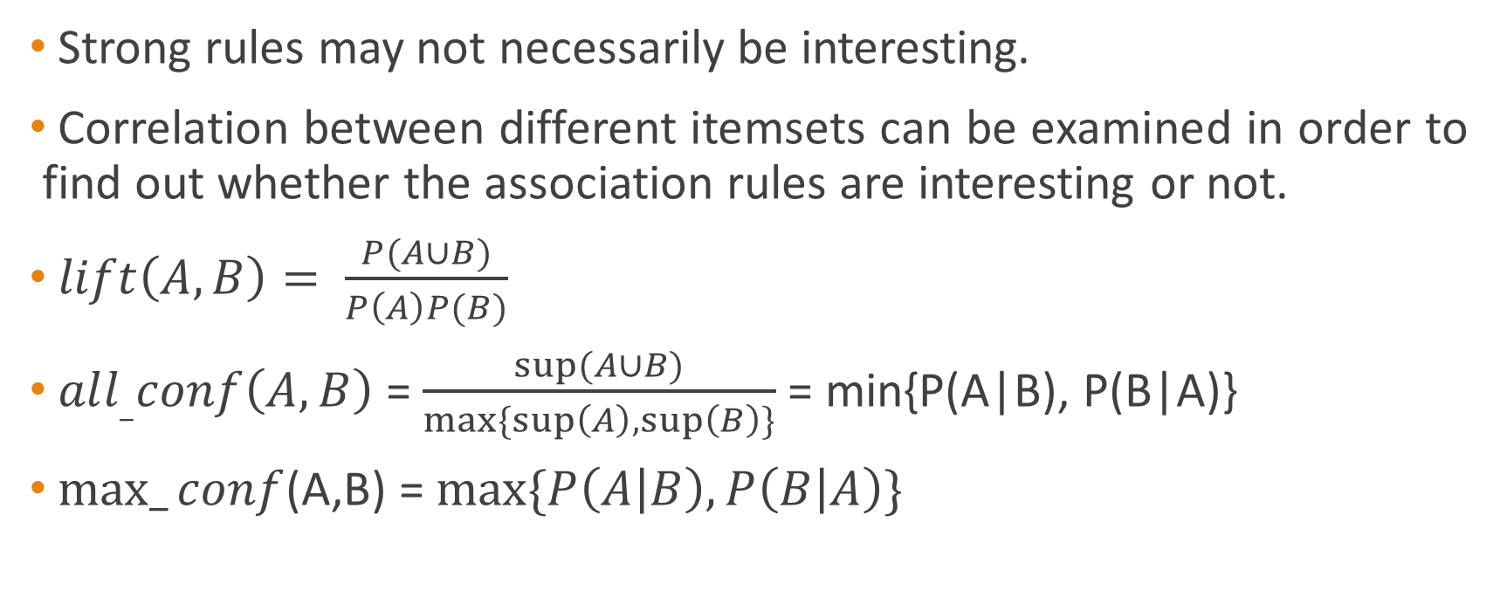
Pattern Evaluation Methods

Slide 8
Next Class
Introduction to Clustering

